Slide 1
Funding the Multinational Firm

Slide 2
Learning Objectives
Compare the weighted average cost of capital for an MNE with its domestic counterpart.
Design a strategy to source capital globally.
Describe the various financial instruments that can be used to source equity in the global equity markets.
Explore the different structures that can be used to source debt globally.

Slide 3
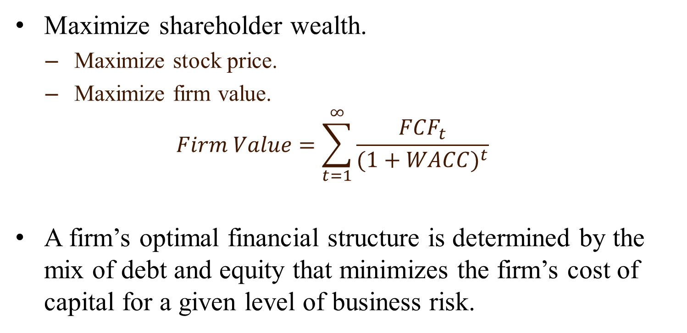
Goal for International Financial Management
Maximize shareholder wealth.
Maximize stock price.
Maximize firm value.
$$Firm Value=\sum_{t=1}^{∞}{\frac{{FCF}_{t}}{{(1+WACC)}^{t}}}$$
A firm’s optimal financial structure is determined by the mix of debt and equity that minimizes the firm’s cost of capital for a given level of business risk.

Slide 4
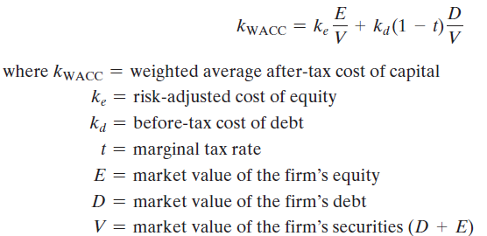
Weighted Average Cost of Capital
A firm’s weighted average cost of capital (WACC) combines the cost of equity with the cost of debt in proportion to the relative weight of each in the firm’s optimal long-term financial structure:

Slide 5
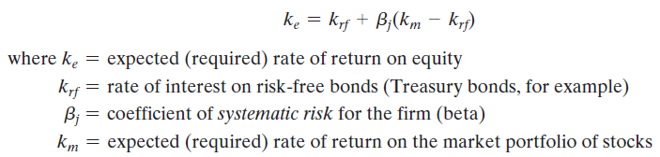
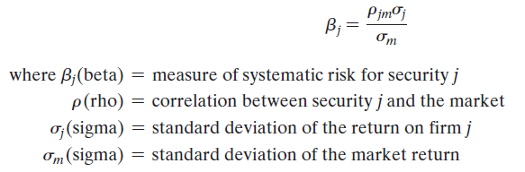
Cost of Equity
The capital asset pricing model (CAPM) approach is to define the cost of equity for a firm by the following formula:
The key component of CAPM is beta, the measure of systematic risk.
If beta < 1.0 returns are less volatile than the market
If beta = 1 returns are the same as the market
If beta > 1.0 returns are more volatile than the market

Slide 6
Cost of Debt
Firms acquire debt financing in the form of loans from commercial banks or as securities sold to the debt market, such as corporate bonds.
The interest costs of different debt components are then averaged (according to their proportion) to calculate the before-tax average, k_{d}, then adjusted for corporate income taxes by multiplying it by (1- tax rate), to obtain k_{d}(1 - t), the weighted average after-tax cost of debt.

Slide 7
When we calculate the WACC, we implicitly assume the equity and debt capital would always be available at the same required rate of return when the firm increase its investment scale.
However, the cost and availability of capital depends on the market liquidity and segmentation.
Market liquidity: the degree to which a firm can issue a new security without depressing the existing market price (increasing the required rate of return)
A national capital market is segmented if the required rate of return on securities in that market differs from the required rate of return on securities of comparable risk traded on other securities markets.
Capital market segmentation is caused mainly by:
government constraints;
institutional practices;
investor perceptions.

Slide 8
Global Cost and Availability of Capital
Global capital markets have given many firms access to lower global cost and greater availability of capital.
In the domestic case, a firm’s marginal cost of capital will eventually increase as suppliers of capital become saturated with the firm’s securities.
In the multinational case, a firm is able to tap many capital markets above and beyond what would have been available in a domestic capital market only. In addition, the international pricing of the firm’s securities may also lower the cost of capital.
Raising funds in the euromarkets, selling securities aboard.
It is especially important for a firm which is located in a country with illiquid, small, and/or segmented capital markets to gain access to highly liquid global markets.

Slide 9
The Role of International Portfolio Investors
What motivates investors to go global?
International diversification
Internationally diversified portfolios often have a lower level of portfolio risk for a given expected rate of return since national securities markets are imperfectly correlated with one another.
Different from domestic portfolio diversification, acquiring a foreign currency-denominated asset is equivalent to acquiring two assets—the currency of denomination and the asset subsequently purchased with the currency.

Slide 10

International CAPM (ICAPM)
ICAPM assumes the financial markets are global, not just domestic.
The risk-free rate is unlikely to change much, but beta and market risk premium easily could change.

Slide 11
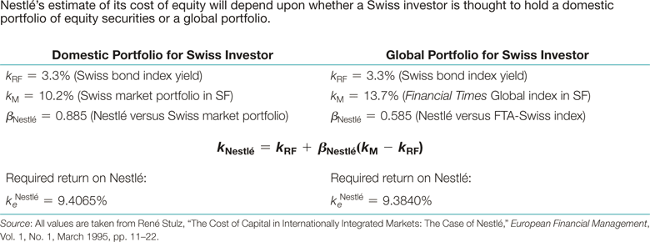
Example of ICAPM

Slide 12
Raising Equity Globally
Four major equity alternatives available to multinational firms.
Public pathway
Initial public offering (IPO).
Seasoned offering.
Depositary receipts.
Euroequity—the initial sale of shares in two or more markets and countries simultaneously.
Private pathway
Private placement.

Slide 13
Depositary receipts are certificates issued by a depository bank to represent the underlying shares of stock, which are held in trust at a foreign custodian bank.
American depository receipts (ADRs) are traded in the United States and denominated in US dollars.
Examples include Cemex (ticker symbol CX, Mexico), China Telecom Corp. (CHA, China), Nokia (NOK, Finland), Heineken (HINKF, Netherlands), Alibaba (BABA, China), and Credit Suisse Group (CS, Switzerland).
ADRs are sold, registered, and transferred in the US in the same manner as any share of stock with each ADR representing some multiple of the underlying foreign share.
ADRs also convey certain technical advantages to U.S. shareholders, such as dividends in $, lower trading cost, and faster settlement.
ADRs can be exchanged for the underlying foreign shares, or vice versa, so arbitrage keeps foreign and U.S. prices of any given share the same after adjusting for transfer costs.
Shares of Toyota are listed as an ADR on the NYSE, with each ADR representing 2 shares. The Toyota share closes at ¥6604 in Tokyo Stock Exchange, the exchange rate is ¥ 109.48/$, what should the Toyota ADR price be?

Slide 14
Private placement is the sale of a security to a small set of qualified institutional buyers.
Passive investors (e.g., Rule 144A investors).
In 1990, the SEC approved Rule 144A. It permits qualified institutional buyers (QIBs) to trade privately placed securities without requiring SEC registration.
A QIB is an entity owns and invests on a discretionary basis $100 million in securities.
The SEC estimates that about 4,000 QIBs exist, mainly investment advisors, investment companies, insurance companies, pension funds, and charitable institutions.
Active investors(e.g., private equity fund).
Private equity funds are usually limited partnerships of institutional and wealthy investors, such as college endowment funds,
They usually seek control of publicly owned firms, taking them private, improving management, and then reselling them after one to three years such as selling the firms to other firms, to other private equity funds, or by taking them public once again.
The securities through private placement are not registered for sale to the public, thus holders don’t enjoy an open and liquid market for exchange of the issue.
A trading system called PORTAL was established to support the distribution of issues and to create a liquid secondary market for issues.
Both publicly traded and private firms could raise equity through private placement.

Slide 15
Which foreign markets to cross-list shares and sell new equity?
Improve the liquidity of its shares and support a liquid secondary market for new equity issues in foreign markets.
Increase its share price by overcoming mispricing in a segmented and illiquid home capital market.
Increase the firm’s visibility and acceptance to its customers, suppliers, creditors, and host governments.
Establish a liquid secondary market for shares used to acquire other firms in the host market and to compensate local management and employees of foreign subsidiaries.

Slide 16
Cross-listings of stocks do carry costs:
It can be costly to meet the disclosure and listing requirements imposed by the foreign exchange and regulatory authorities.
Public firm financial disclosures can be seen as a tremendous amount of information that customers, suppliers, partners, and competitors may use in their relationship with the firm.
Once a company’s stock is traded in overseas markets, there can be volatility spillover from these markets.
Once a company’s stock is made available to foreigners, they might acquire a controlling interest and challenge the domestic control of the company.

Slide 17
Raising Debt Globally
The international debt market offers the borrower a wide variety of different maturities, repayment structures, and currencies of denomination.
The three major sources of debt funding on the international markets:
Bank loans and syndications (short- to medium-term)
Pricing is typically at LIBOR plus a spread
Euronote market (short- to medium-term)
International bond market (medium-to long term)
Eurobond (80%):
A bond denominated in a particular currency but sold to investors in national capital market other than the country that issued the denominating currency.
Eg. German MNC issuing a dollar-denominated bonds to investors in the UK, and France.
Foreign Bond:
Issued by a foreign borrower to the investors in a national capital market and denominated in that nation’s currency.
Eg. German MNC issuing dollar-denominated bonds to US investors.

Slide 18
Unique Characteristics of Eurobond Markets:
Absence of regulatory interference
National governments often impose tight controls on foreign issuers of securities denominated in local currencies, although governments generally have less stringent limitations for securities denominated in foreign currencies and sold within their markets.
Less stringent disclosure
Disclosure requirements less stringent than those of the SEC.
Favorable tax status
Eurobonds offer tax anonymity and flexibility.
Bearer form , interests are not subjected to the income tax.

Slide 19
Types of Eurobond
Straight fixed-rate debt
These are “plain vanilla” bonds with a specified coupon rate and maturity and no options attached.
Eurobonds typically pays coupon annually
Floating-rate notes
Common reference rates are 3-month and 6-month U.S. dollar LIBOR.
Eg. A 5-year FRN on $1,000 with coupons referenced to 6-month dollar LIBOR paying coupon interest semiannually, At the beginning of every 6-month period, the next semiannual coupon payment is reset to be 0.5 * (LIBOR + 1/8)% of face value. If the current 6-month LIBOR is 6.6%, what is the next period coupon payment?
Equity-related bonds
Convertible bond allows the investor to exchange the bond for a predetermined number of equity shares of the issuer.
Bond with equity warrant allows the holder to keep the bond but still buy a specified number of shares in the firm of the issuer at a specified price.

Slide 20
Revisit the learning objectives
Compare the weighted average cost of capital for an MNE with its domestic counterpart.
Design a strategy to source capital globally.
Describe the various financial instruments that can be used to source equity in the global equity markets.
Explore the different structures that can be used to source debt globally.

